Slide 1
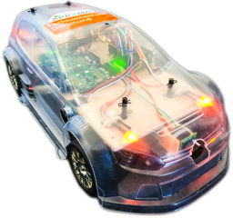
Developing a Multicore RC-Car with APP4MC
Mustafa Özçelikörs, Robert Höttger
EclipseCon Ludwigsburg, Germany
26.10.2016

Slide 2
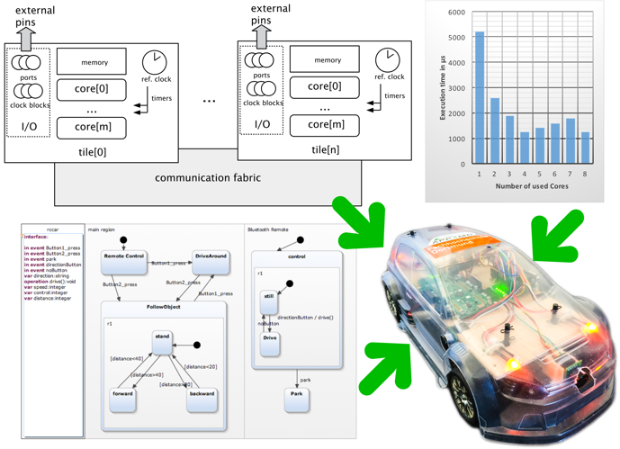
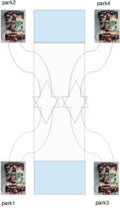
RC Car

Slide 3
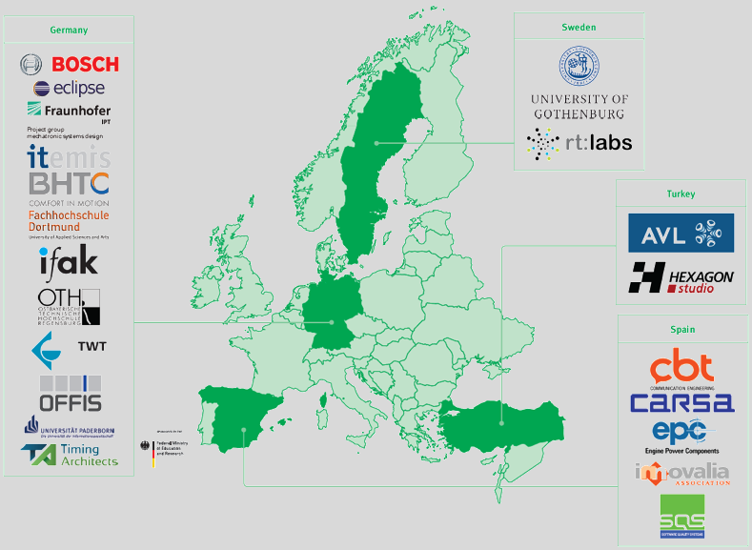
APP4MC (aka Amalthea) I
An open source development platform for embedded multi- and many-core systems
Itea2 project
German funding by BMBF
20 partners
7,8 mio€
80 person years
Sep.2014 – Aug.2017
Notes:
Who?
Project

Slide 4
APP4MC (aka Amalthea) II
Notes:
What?

Slide 5
APP4MC (aka Amalthea) III
Notes:
What?
Requirements, System Architecture, System design, Software architecture, Software implementation
Unit Test, Integration Test, System, System integration, Use

Slide 6
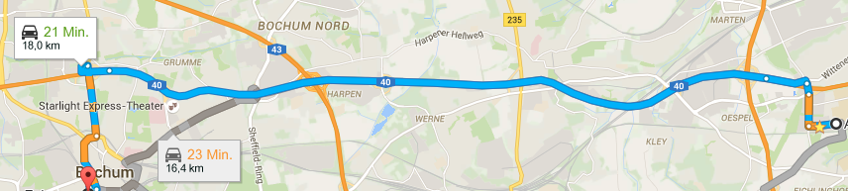
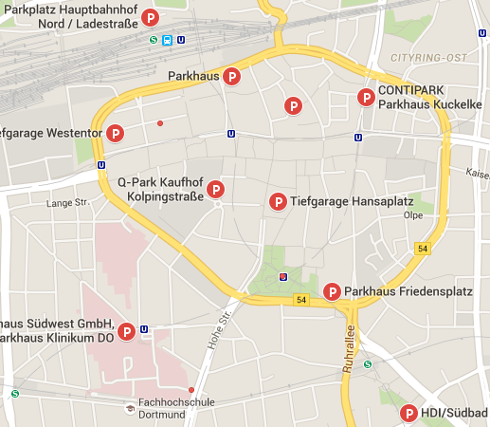
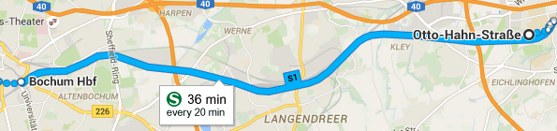
Challenges I
Platform provides interfaces to allow individual tool-chain tailoring based on a common format
→ open standard, increased interoperability and data exchange
Costs
Time
Resources
Environment
Traffic
Hardware
Dependencies
Infrastructure
Speed
Notes:
Why?

Slide 7
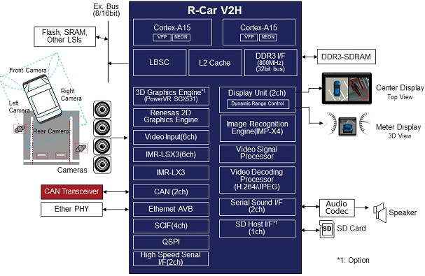
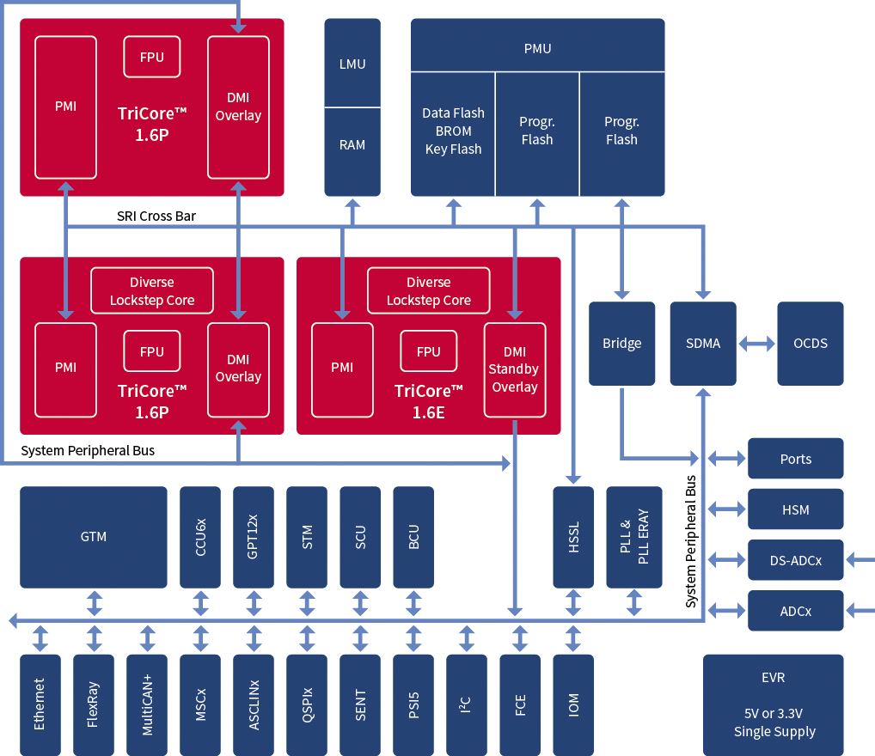
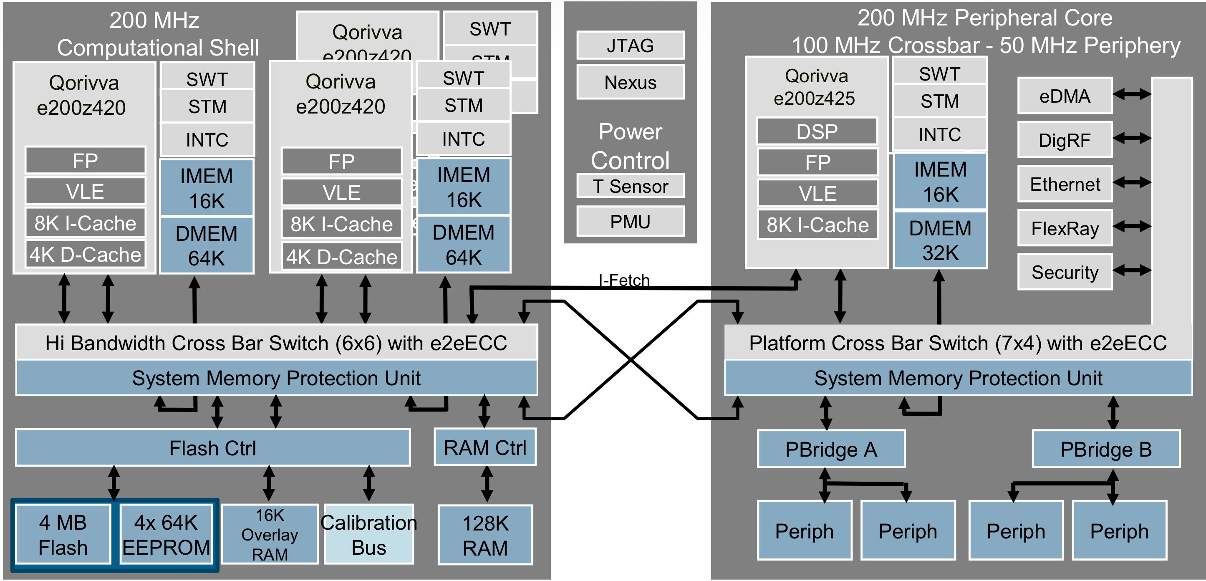
Challenges II
Source: www.autosar.org
Source: www.renesas.eu
Source: www.infineon.com
Source: www.nxp.com

Slide 8
From multi-core to many-core
Multi-core
Few homogeneous cores with shared memory
Symmetric communication (e.g. crossbar)
Limited influence to software distribution
Many-core
High amount of homogeneous and heterogeneous cores, distributed memory
Heterogeneous communication (non uniform memory access)
High influence to software distribution

Slide 9
Embedded Multicore
Software distribution and memory mapping defines
Response time
Core utilization
Energy consumption
Costs
Efficiency
Durability
...
Automation safes efforts, creates better solutions and is less error prone

Slide 10
Task Management

Slide 11
Task Distribution

